Slide 1


Abdul Fall
09/27/2021

Slide 2

Outline
Executive Summary
Introduction
Methodology
Results
Conclusion
Appendix

Slide 3
Executive Summary
Problem Solution
SpaceX has been advertising the sell of its SpaceX’s savings comes from the fact that
Falcon9 rocket launches, which costs are the company is able to reuse the first
lower than other providers. SpaceX utilizes stage of a launch, which means that if we
the re-usibility of the first stage of a launch we can determine if the first stage will
in order to do some savings. Thus, how is land, we can determine the cost of a
SpaceX able to achieve this and make the launch as the first stage do most of the
cost of its rockets inexpensive? work and also determine if SpaceX will
reuse the first stage.

Slide 4
Introduction
SpaceY, a rocket company and a competitor of SpaceX, is trying to gather data from SpaceX in order to be more competitive as SpaceX’s accomplishments makes them the most successful rocket company in the country.
SpaceY would like to determine to price of each launch by gathering data from SpaceX and determine if SpaceX will reuse the first stage, as the first stage is the larger stage and expensive, thus by knowing how much the first stage will cost if the Falcon9 rockets land successfully, SpaceY will be able to adopt the strategy enabling them to compete with SpaceX and save in terms of capital that they allocate to the launch of the rockets.

Slide 5


Slide 6
Methodology
Executive Summary
Data collection methodology:
The Data was collected through the SpaceX REST API (api.spacexdata.com/v4/launches /past), which gave us information and data about launches, rocket use, specifications, landing outcome. The data will give insights and predictions whether SpaceX will attempt to land a rocket or not.
Perform data wrangling
The Data was processed and, the number of launches on each site, the number and occurrence of each orbit, mission outcome per orb and landing outcome were calculated.
Perform exploratory data analysis (EDA) using visualization and SQL
Perform interactive visual analytics using Folium and Plotly Dash
Perform predictive analysis using classification models
How to build, tune, evaluate classification models

Slide 7
Data Collection – SpaceX API
The data was collected by performing an HTTP GET method to request the Falcon9 launch HMTL page as an HTTP response. Then the relevant column names were collected from the HTML table header.
https://github.com/Emporio95/Master-/blob/6d46dafaf42e10f7e1f9f880f642334bd0a5fca3/Data%20Collection%20with%20Web%20Scraping.ipynb
request
Spacex_url
responses
Web server
normalize
Request
Start
Line
get(spacex_url)
Request
Header
requests.get(static_url)
Response
Start
Line
HTTP/1.0 200 OK
Response
Header
Response
Body
<tbody><tr> <th scope="col">Flight No. </th> <th scope="col">Date and<br/>time (<a href="/wiki/Coordinated_Universal_Time" title="Coordinated Universal Time">UTC</a>) </th> <th scope="col"><a href="/wiki/List_of_Falcon_9_first-stage_boosters" title="List of Falcon 9 first-stage boosters">Version,<br/>Booster</a> <sup class="reference" id="cite_ref-booster_11-0"><a href="#cite_note-booster-11">[b]</a>/sup> </th> <th scope="col">Launch site </th> <th scope="col">Payload<sup class="reference" id="cite_ref-Dragon_12-0"><a href="#cite_note-Dragon-12">[c]</a></sup> </th> <th scope="col">Payload mass </th> <th scope="col">Orbit </th> <th scope="col">Customer </th> <th scope="col">Launch<br/>outcome </th>
Server: Apache-cache:Unreachable

Slide 8
Data Wrangling
During this phase, the data was analyzed, and the main steps consisted of calculating the number of launch on each site, the number and occurrence of each orbit and mission outcome per orbit and creating a landing outcome label
https://github.com/Emporio95/Master-/blob/6d46dafaf42e10f7e1f9f880f642334bd0a5fca3/EDA:%20Data%20Wrangling%20.ipynb

Slide 9
EDA with Data Visualization
During the phase, scatter point charts were plotted in order to visualize and reveal the relationship between attributes such as flight number, orbits, payload and launch site. Then a line chart was plotted to observe the launch success yearly trend which showed that success rate has been increasing since 2013.
https://github.com/Emporio95/Master-/blob/6d46dafaf42e10f7e1f9f880f642334bd0a5fca3/EDA%20with%20Data%20Visualization.ipynb

Slide 10
EDA with SQL
Using bullet point format, summarize the SQL queries you performed
We determine the names of unique launch sites by using the count and distinct function.
Then we found 5 records where launch sites begin with “CCA”
Then we calculated the total payload mass launched by NASA(CRS) with the sum function.
Then, we listed the total number of successful and failure missions outcome with the count function.
The through sub-query, we listed the names of booster versions that have carried the maximum payload mass.
https://github.com/Emporio95/Master-/blob/6d46dafaf42e10f7e1f9f880f642334bd0a5fca3/EDA%20with%20SQL.ipynb

Slide 11
Build an Interactive Map with Folium
With a folium map object, we were able to visualize geographically all launch sites and create markers as icons for each NASA Space centers. Then, we created a circle object and added the launch site name as a popup label. Afterwards, we created a marker cluster object for all launch records to see the success/failed launches for each site because many launch records have the exact coordinates. Finally, we calculated the distances between a launch site to its proximities and a folium marker object to show the distance.
https://github.com/Emporio95/Master-/blob/6d46dafaf42e10f7e1f9f880f642334bd0a5fca3/Interactive%20Visual%20Analytics%20with%20Folium.ipynb

Slide 12
Build a Dashboard with Plotly Dash
Building a dashboard allows us to visualize the data interactively and in real time with updated data. The dashboard we built has a dropdown list that allows us to choose the launch site, an interactive pie chart showing the total successful launches count for all sites, a scatter chart to show the correlation between payload and launch success and a slider to select the payload range.
https://github.com/Emporio95/Master-/blob/6d46dafaf42e10f7e1f9f880f642334bd0a5fca3/spacex_dash_app.py

Slide 13
Predictive Analysis (Classification)
For the phase, we built classification model in order to identify the best method for our machine learning model. First, we created a column for the class, standardize the data and split into training data and test data.
The first method used was the logic regression method. We display the best parameters and accuracy of the data. Then we calculated the accuracy on the test data.
The second method used was the vector machine method. The best parameters were found, then with the GridSearchCV Object, we calculated the accuracy of the trained data before calculating the accuracy on the test data with the method score.
The third method was the decision tree method, and the last method was the K-nearest neighbor method, both methods followed the same procedures as the previous two.
After analyzing those four algorithms, we realized that they all give the same result in terms of accuracy on the test data and close to the same accuracy on the data which the confusion matrix shows.
https://github.com/Emporio95/Master-/blob/6d46dafaf42e10f7e1f9f880f642334bd0a5fca3/Machine%20Learning%20Prediction.ipynb

Slide 14
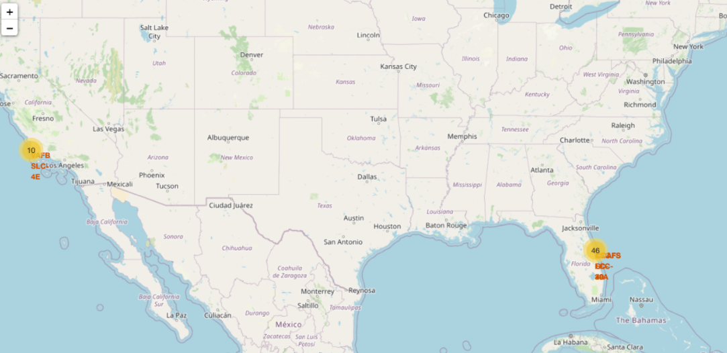
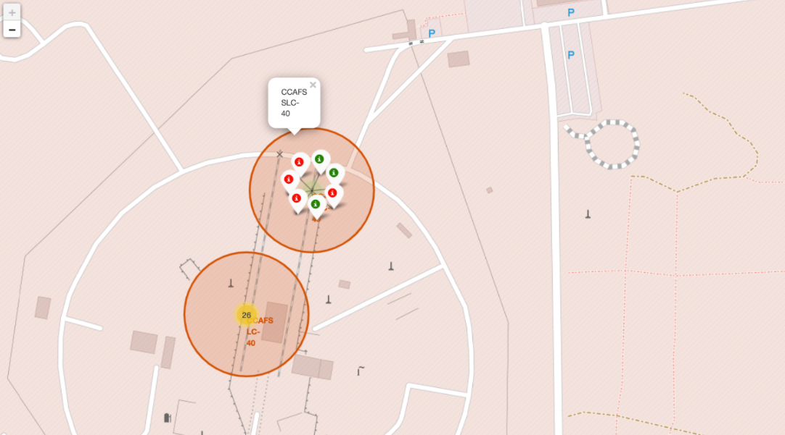
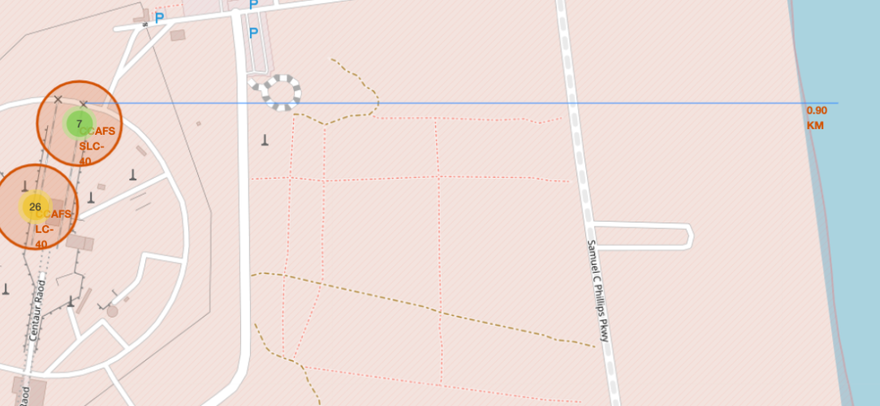
Results
Exploratory data analysis results
From the exploratory data analysis done, we can see that there has been much more successful mission outcomes since 2013 and the success rate of a launch is close to 70%.
Interactive analytics demo in screenshots
Predictive analysis results
All the algorithms analyzed during the machine learning/classification model turned out to have the same accuracy. Thus, we can say that they can all perform best as the accuracy on the test data and on the data itself is high.

Slide 15


Slide 16
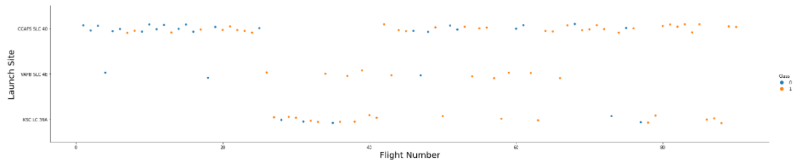
Flight Number vs. Launch Site
Scatter plot of Flight Number vs. Launch Site
From this scatter plot showing the relationship between flight number and launch site we can see that the CCAFS SLC launch site has more reuse rocket launch as the number of flight increase which means that this launch site has a higher probability of successful landing than other launch sites. In other words, high flight number have a positive influence on the CCAFS SLC 40 launch site

Slide 17
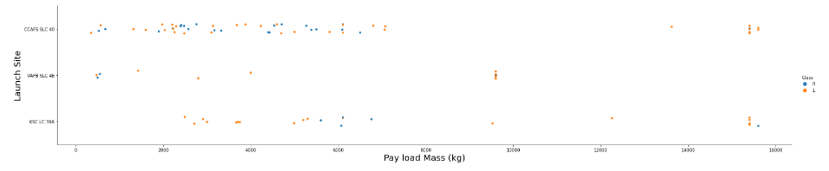
Payload vs. Launch Site
Scatter plot of Payload vs. Launch Site
From this scatter plot, we can see that heavy payloads have a negative impact on the
launch site for the most part but has positive influence on the CCAFS SLC 40 launch
site.

Slide 18
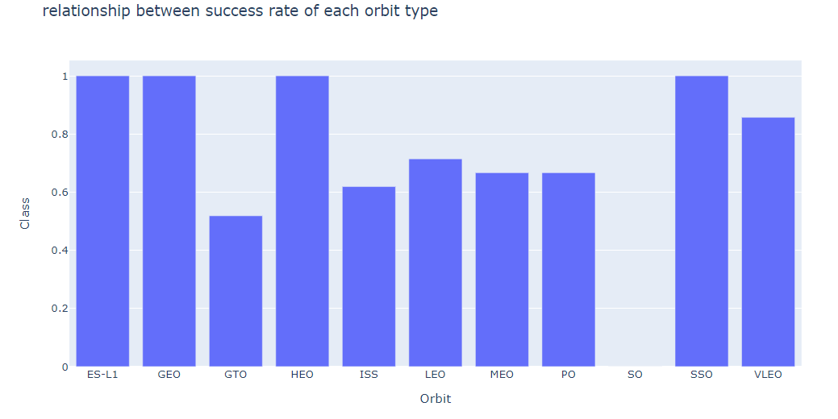
Success Rate vs. Orbit Type
Bar chart for the success rate of each orbit type
From the plotted bar chart, we can see that the orbits ES-l1,GEO,HEO,SSO have the
highest rate of success.

Slide 19
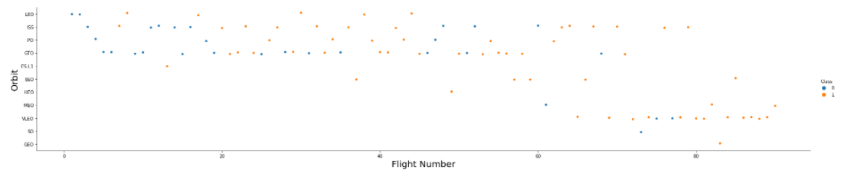
Flight Number vs. Orbit Type
Scatter point chart of Flight number vs. Orbit type
From the scatter point chart, we can see that there is relationship between the LEO
orbit and the number of flight number and there seems to be no relationship
between the number of flights and the rest of the orbits.

Slide 20
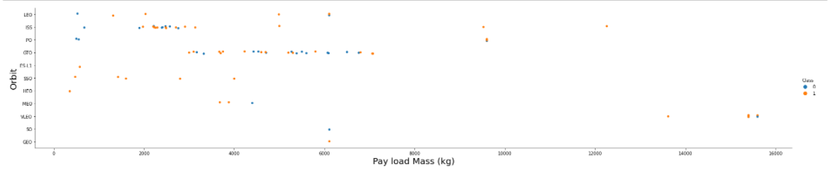
Payload vs. Orbit Type
Scatter point chart of payload vs. orbit type
From this plotted scatter point chart, we can see that heavy payloads have a negative influence on GTO
orbits but have positive influence on Polar LEO (ISS) orbits.

Slide 21
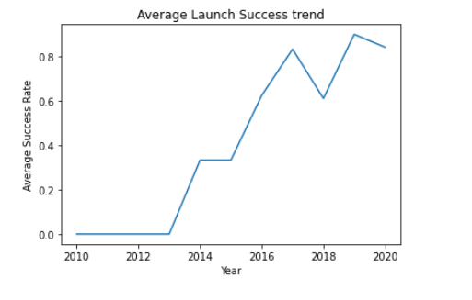
Launch Success Yearly Trend
Line chart of yearly average success rate
From this line chart, we can see that the success rate has been increasing since the
year 2013.

Slide 22
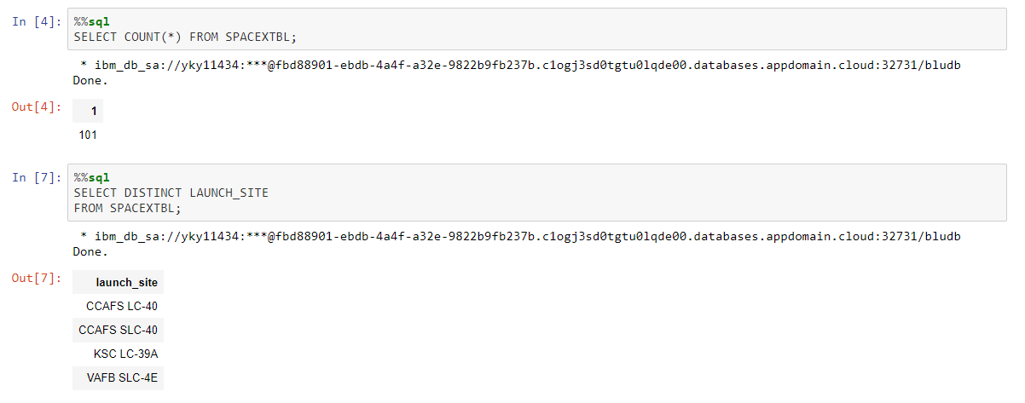
All Launch Site Names
Names of the unique launch sites
We can see that there are only four unique launch sites

Slide 23
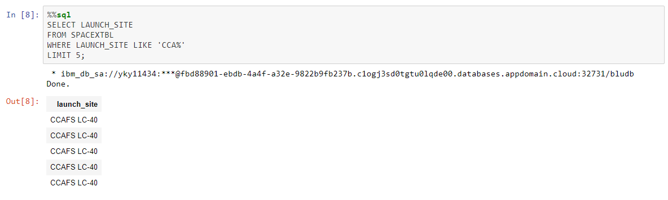
Launch Site Names Begin with 'CCA'
5 records where launch sites begin with `CCA`
This sql query shows the records of 5 launch sites beginning with “CCA” and we can see that they all come from the
Launch site CCAFS LC-40.

Slide 24
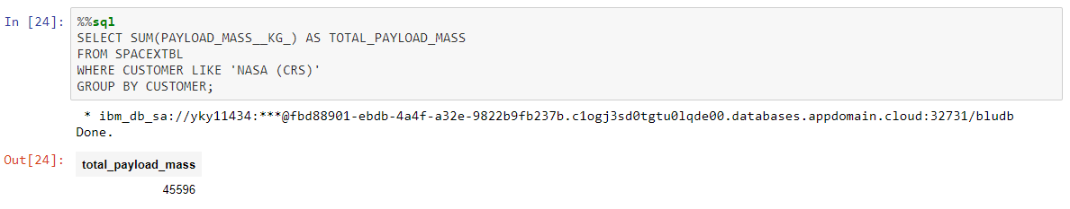
Total Payload Mass
Total payload carried by boosters from NASA
This SQL query shows the total payload mass carried by boosters from NASA, which was calculated with the
Sum function and group by customer.

Slide 25
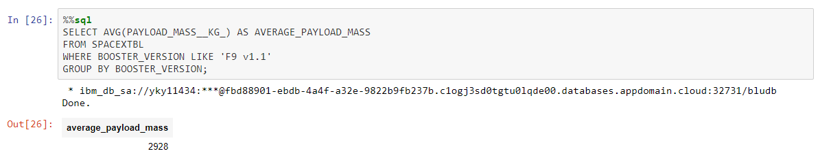
Average Payload Mass by F9 v1.1
Average payload mass carried by booster version F9 v1.1
The average payload mass carried by booster version F9 v1.1 was calculated with
The avg function then group by booster version so the average only apply for F9
v1.1

Slide 26
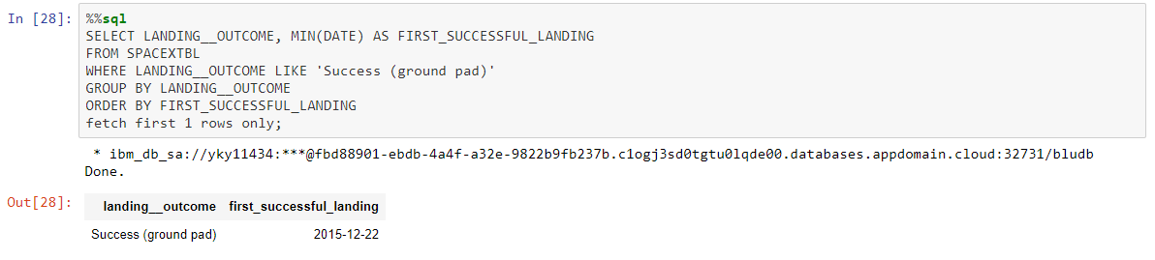
First Successful Ground Landing Date
Dates of the first successful landing outcome on ground pad
We can see that the date of the first successful landing outcome on ground pad was on December 22,2015.
The aggregate function MIN was used to find the result then grouped by landing outcome
And filtered in ascending order.

Slide 27
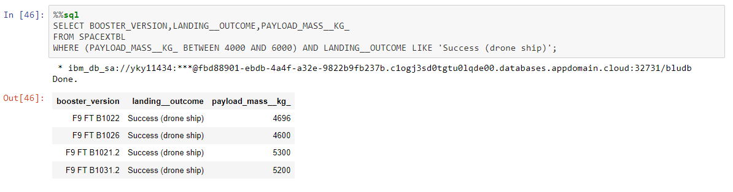
Successful Drone Ship Landing with Payload between 4000 and 6000
Names of boosters which have successfully landed on drone ship and had payload mass greater than 4000 but less than 6000
We see that four boosters have successfully landed on drone ship and had payload
mass greater than 4000 but less than 6000.

Slide 28
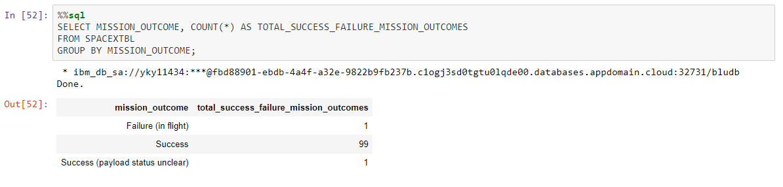
Total Number of Successful and Failure Mission Outcomes
Total number of successful and failure mission outcomes
We can see that there are considerably higher number of success outcome (99) as opposed to other outcomes such as failure or status unclear, which total to 2.

Slide 29
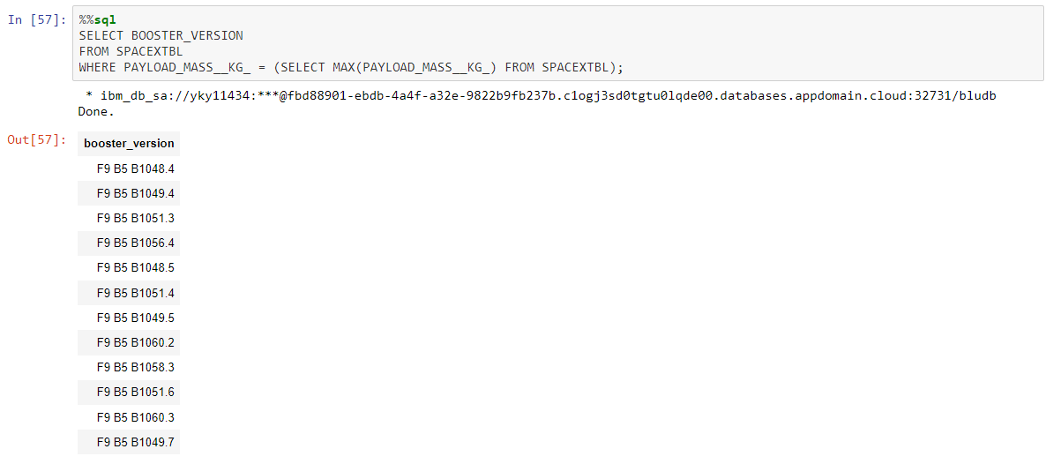
Boosters Carried Maximum Payload
Names of the booster which have carried the maximum payload mass
Through a sub-query, we found that a total of 12 boosters have carried the
maximum payload mass.

Slide 30
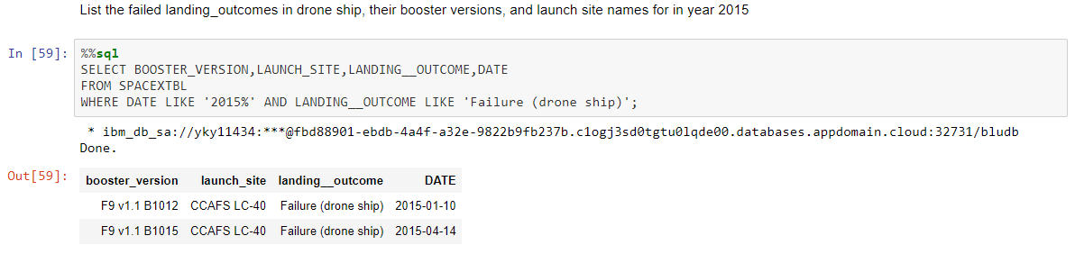
2015 Launch Records
Failed landing_outcomes in drone ship, their booster versions, and launch site names for in year 2015
Two F9 boosters from the same launch site had failed landing outcomes in done ship during the year 2015.

Slide 31
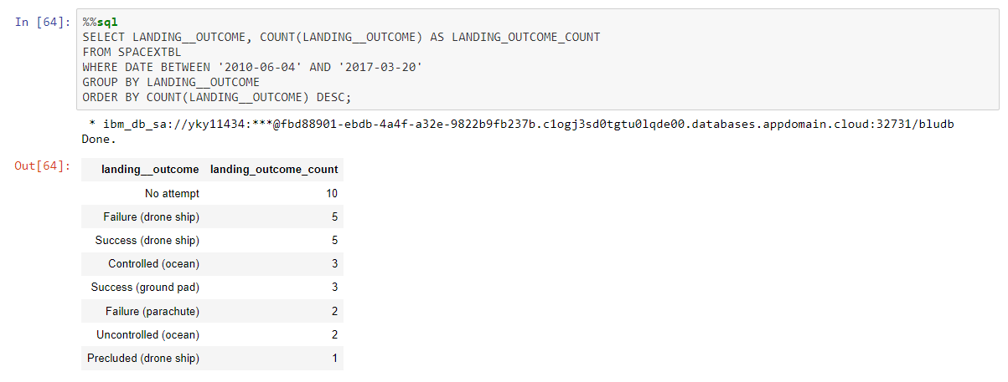
Rank Landing Outcomes Between 2010-06-04 and 2017-03-20
Rank the count of landing outcomes (such as Failure (drone ship) or Success (ground pad)) between the date 2010-06-04 and 2017-03-20, in descending order
Between the two dates stated above, we see that the highest number of landing outcome
comes from the “no attempt” outcomes with 15, failure and success in drone ship have both
the same number of landing outcome count (5) and the least number of landing outcome comes
from the precluded in drone ship landing outcome.

Slide 32


Slide 33
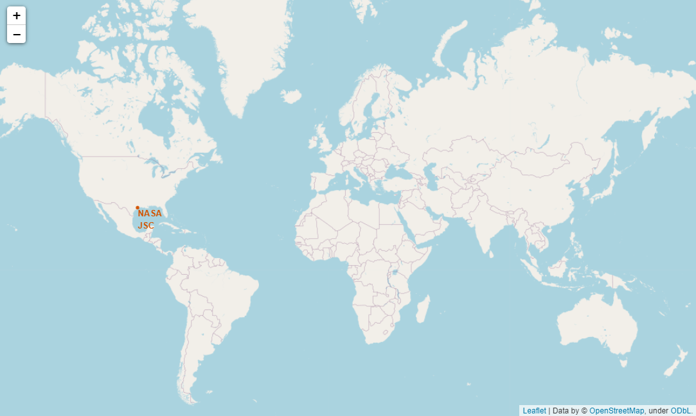
Launch Sites on a global map
All launch sites’ location markers on a global map
We can see that all launch sites are located in in NASA JSC.

Slide 34
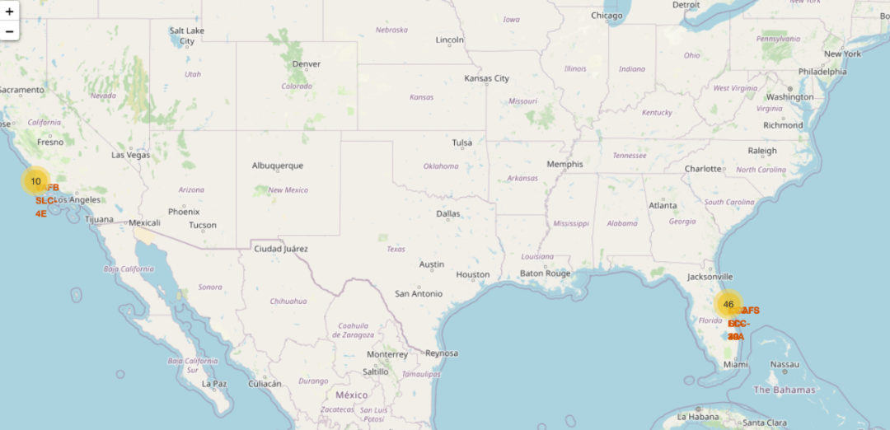

Launch outcome on the map
The color-labeled launch outcomes on the map

Slide 35
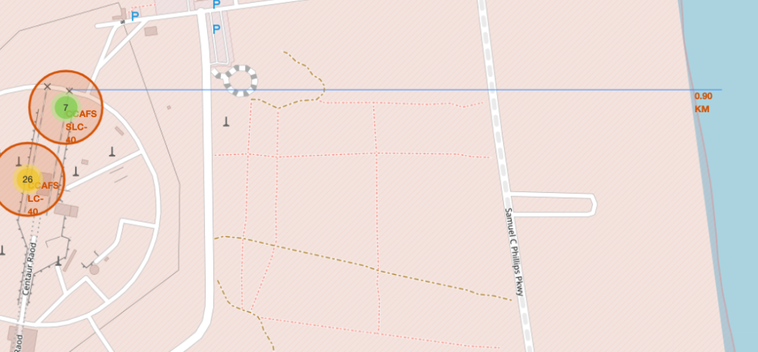
Distances between a launch site to its proximities
Launch site to its proximities such as railway, highway, coastline, with distance calculated and displayed
We can see that the launch site CCAFS SLC-40 is the closest to the coastline with
a distance of 0.9 km.

Slide 36


Slide 37
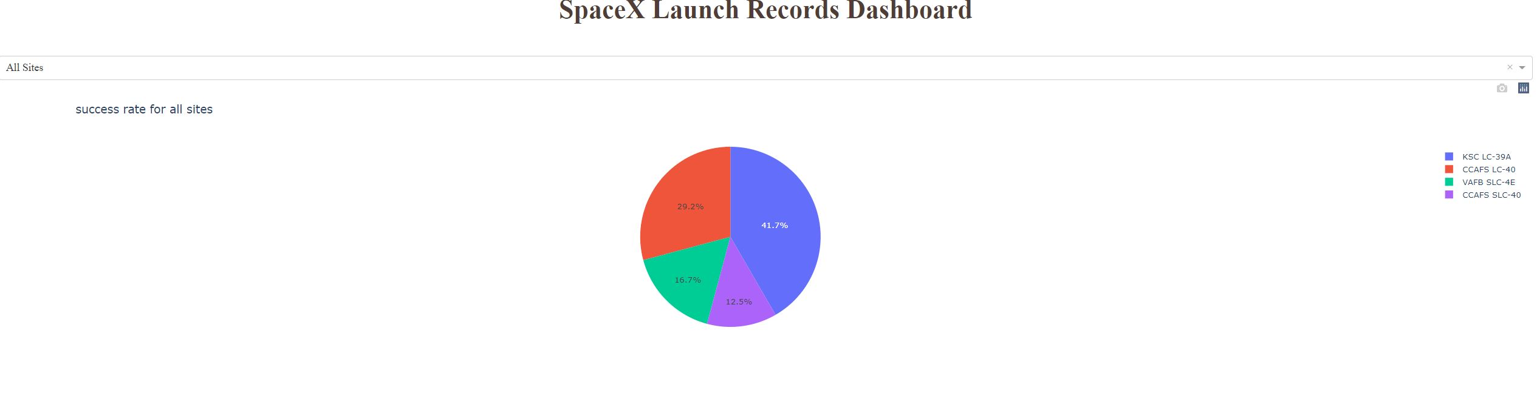
Launch Success Count for all sites
Launch success count for all sites, in a piechart
From this pie chart we can see that the launch site KSC LC-39A has the highest launch
success count with 41.7% while the launch site CCAFS SLC-40 has the lowest.

Slide 38
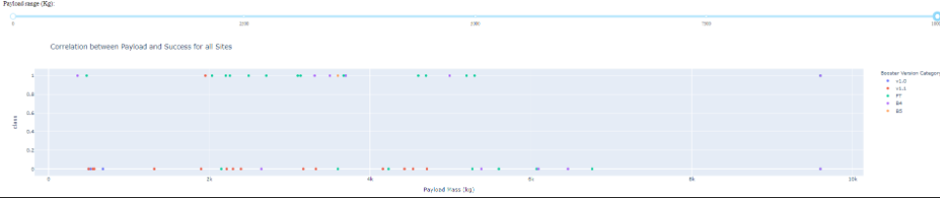
Payload vs. Launch Outcome scatter plot for all sites
Payload vs. Launch Outcome scatter plot for all sites, with different payload selected in the range slider
From this scatter plot, we can see that the range of payload between 2000-4000 and the
booster version v1.1 and FT have the largest success rate.

Slide 39


Slide 40
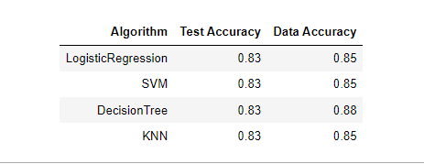
Classification Accuracy
Visualization of the built model accuracy for all built classification models.
All algorithm have the same accuracy on the test data of 83% and same
accuracy on the trained data with the accuracy for the decision tree model slightly
higher.

Slide 41
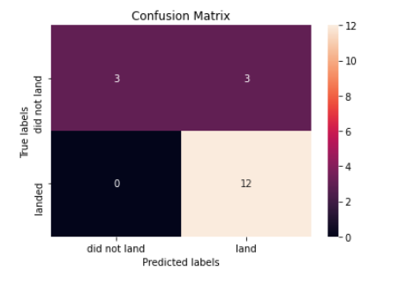
Confusion Matrix
Confusion matrix of the best performing model
All the models have the same confusion matrix, and we can see that we are
getting 12 predicted landing outcome and zero for failure to land. The confusion
matrix was split for actual successful landing and failed landing.

Slide 42
Conclusions
In conclusion, from the analysis done and the machine learning classification models built, we can say that SpaceX has a high probability (66%) of successfully landing the first stage of a launch with a classification prediction of 83.3% for successful landing.
Also, the success rate for successful landing has kept increasing over the past 8 years, which might mean that future launch have also high chances of success of the first stage.
Among the launch sites, CCAFS LC-40, KSC LC-39A and VAFB SLC 4e have the highest success rate, 60%,70% and 70% respectively. Launching the F9 at those launch sites could also lead to successful landing of the first stage.
SpaceX first stage is usually successful as flight number increases and the less massive the payload, the more likely it is to achieve success in the first stage.

Slide 43
Appendix
URL:https://en.wikipedia.org/w/index.php?title=List_of_Falcon_9_and_Falcon_Heavy_launches&oldid=1027686922
URL: https://www.spacex.com/vehicles/falcon-9/

Slide 44


